Slide 1


Paper 1935
Synergistic Image and Feature Adaptation:
Towards Cross-Modality Domain Adaptation for Medical Image Segmentation
Cheng Chen¹, Qi Dou¹, Hao Chen^{1,2}, Jing Qin³ and Pheng-Ann Heng^{1,4}
¹ The Chinese University of Hong Kong
² ImSight Medical Technology Co., Ltd.
³ The Hong Kong Polytechnic University
⁴ Shenzhen Institutes of Advanced Technology

Slide 2
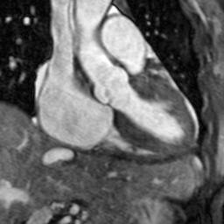
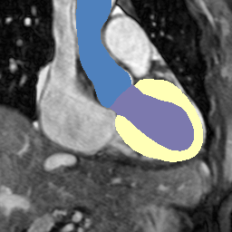
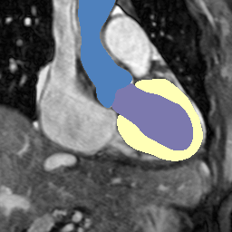
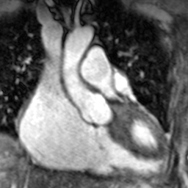
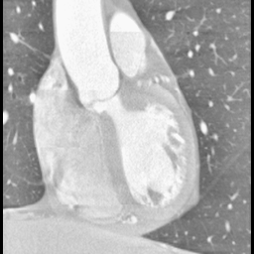
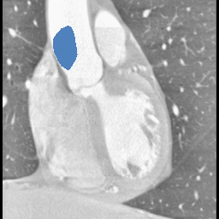
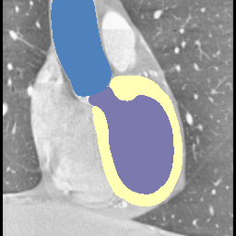
Problem & Challenge
Success of deep neural networks
Assumption: training and testing data are drawn from the same distribution.
Performance degradation
Domain shift: training and testing data present different distributions.
Common situation in medical applications.
Test image
Prediction
Ground truth
Model trained on MR data
Test on MR
Test on CT

Slide 3
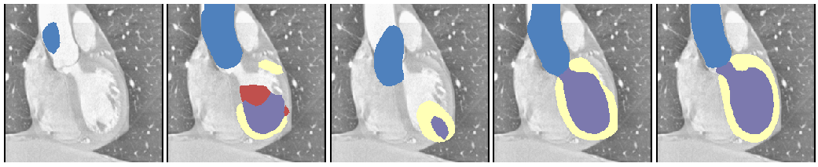
Related works
Unsupervised domain adaptation: adapt from labeled source domain to unlabeled target domain
Image adaptation: align image appearance [Zhu et al. ICCV 2017; Zhang et al. MICCAI 2018]
Feature adaptation: align feature distributions [Tzeng et al. CVPR 2017; Dou et al. IJCAI 2018]
Joint adaptation: combine image and feature adaptation [Hoffman et al. ICML 2018; Zhang et al. CVPR 2018]
W/o adapt
Image adapt
Feature adapt
Ours
Ground truth

Slide 4
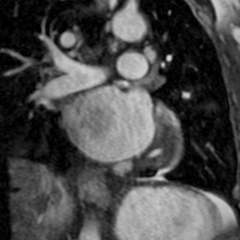
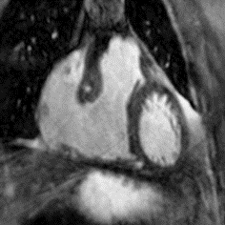
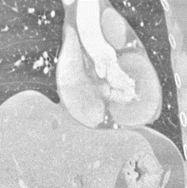
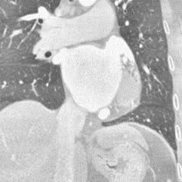
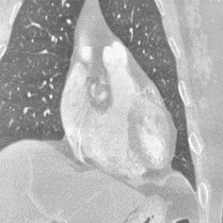
Proposed method
Synergistic image and feature adaptation (SIFA) for unsupervised domain adaptation
Synergistic fusion of adaptations from both image and feature perspectives
Feature encoder is shared to simultaneously transform image appearance and extract domain-invariant representations
Challenging cross-modality medical image segmentation under severe domain shift
MR images (Source)
CT images (Target)

Slide 5
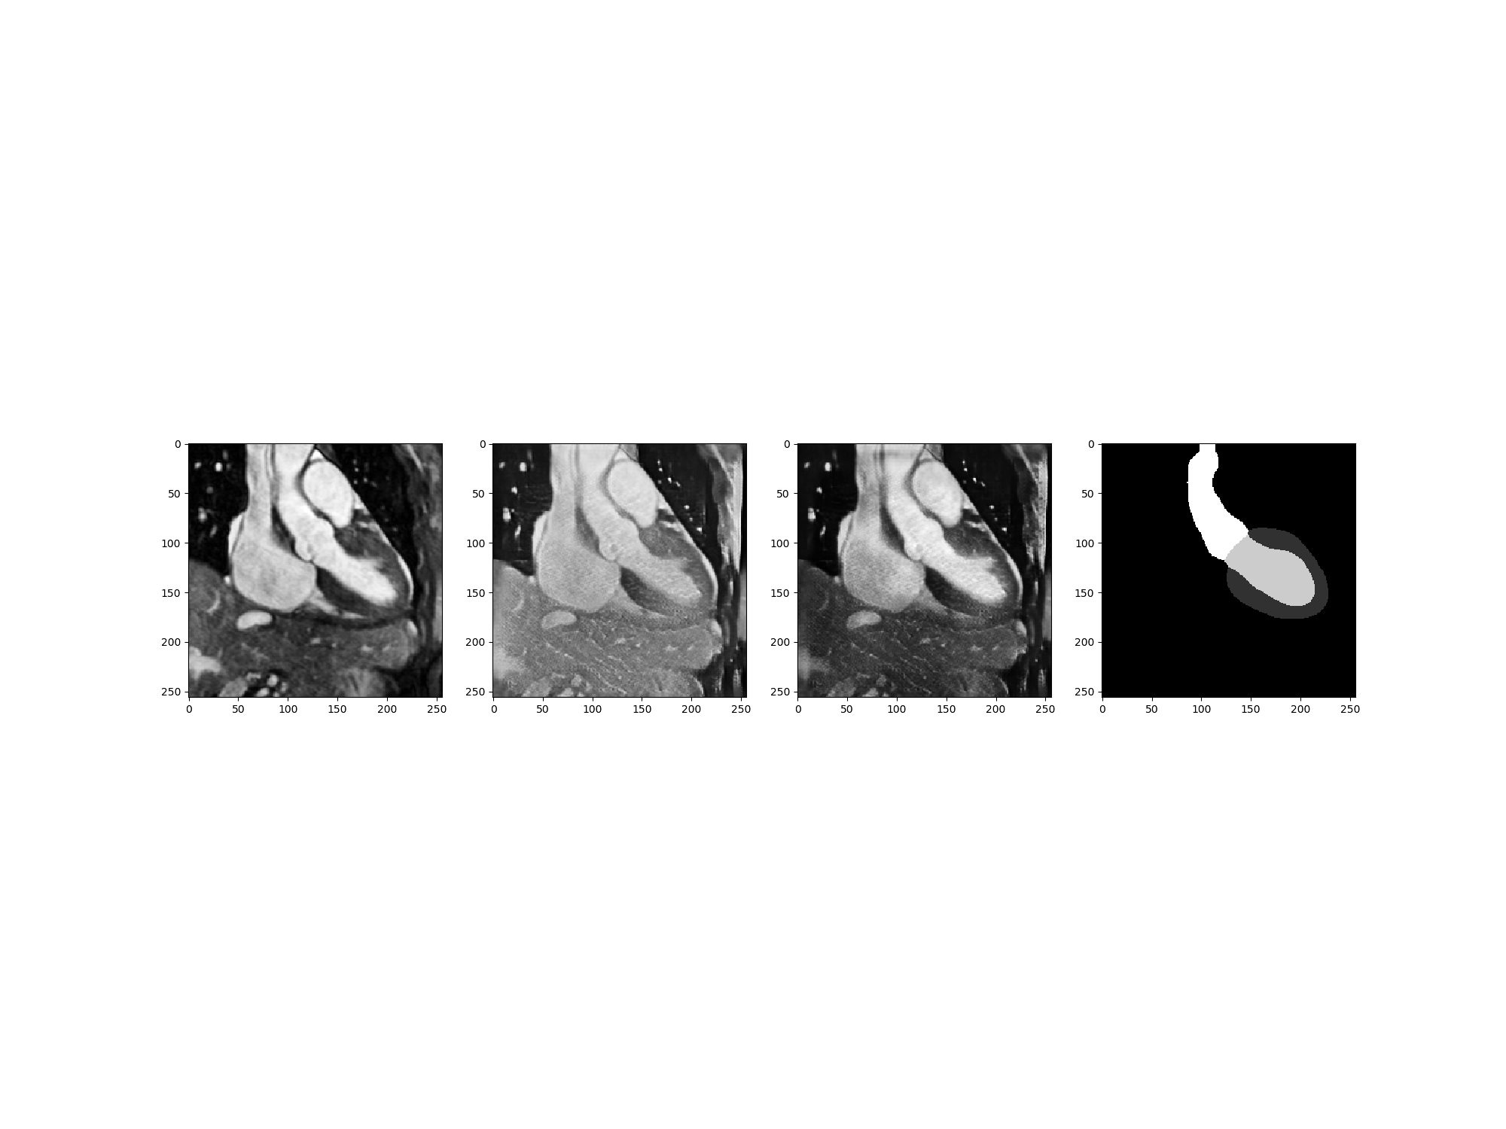
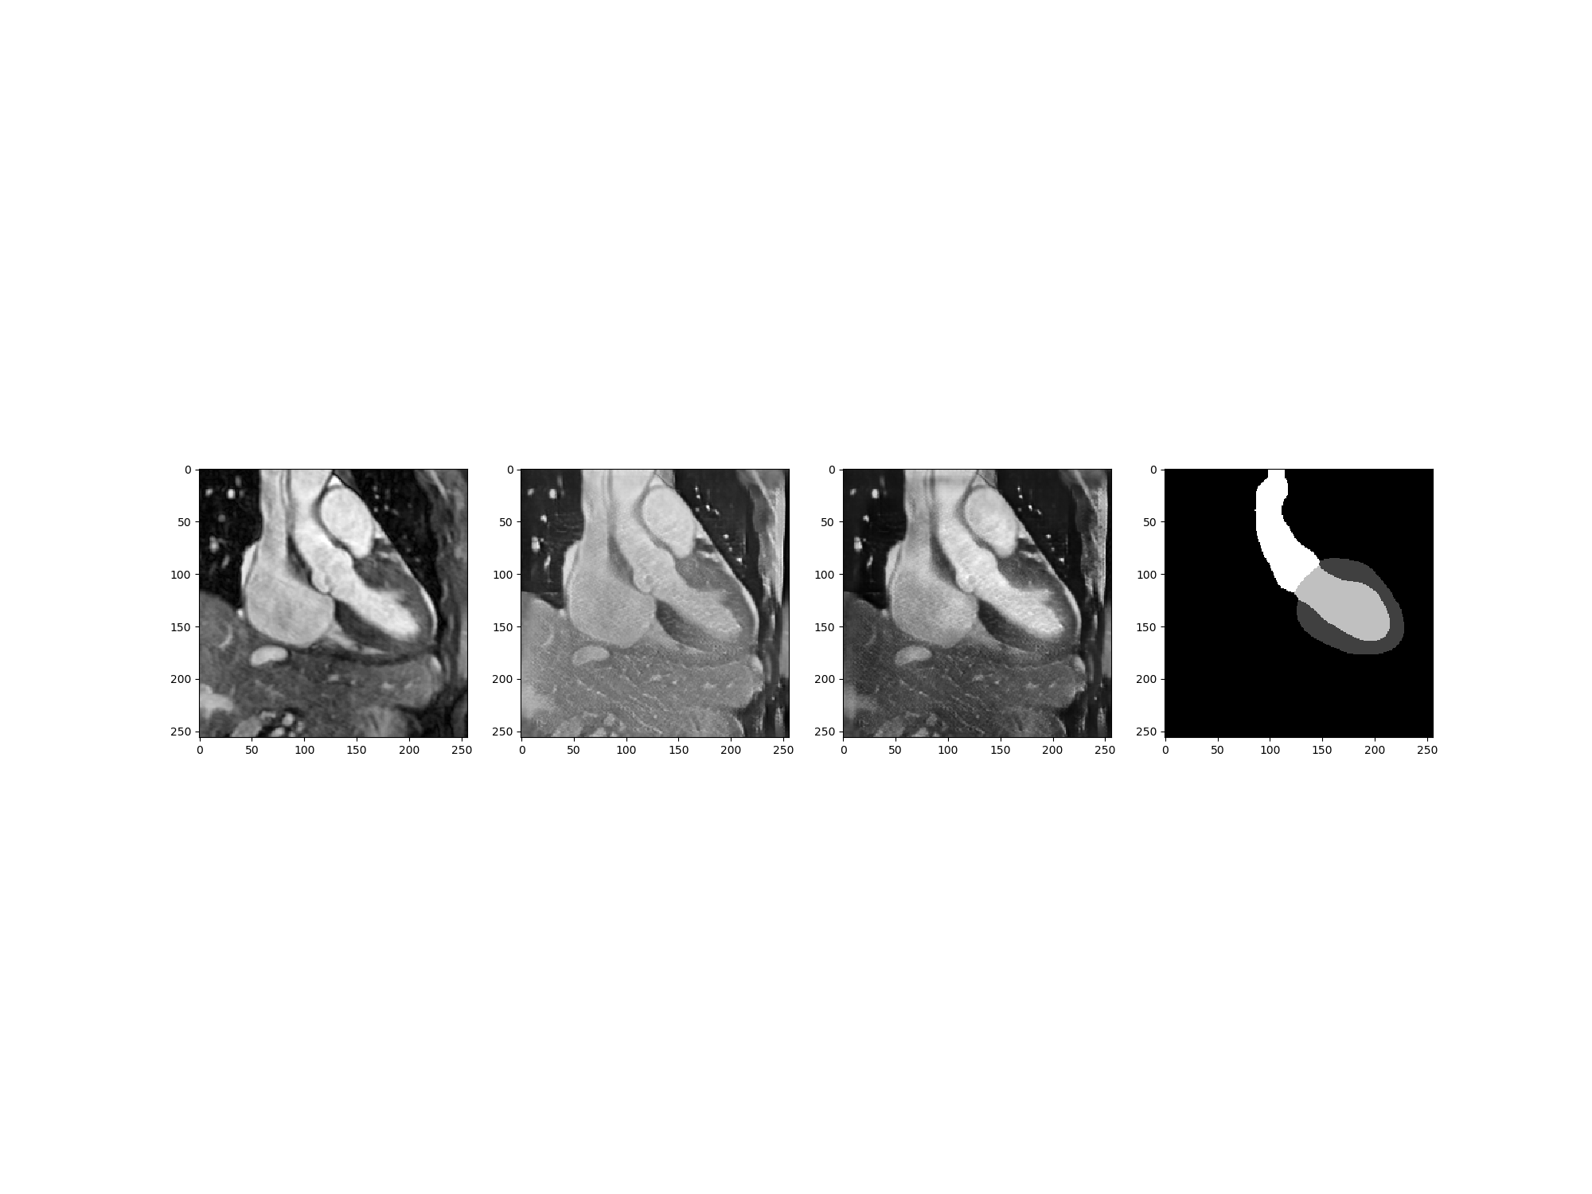
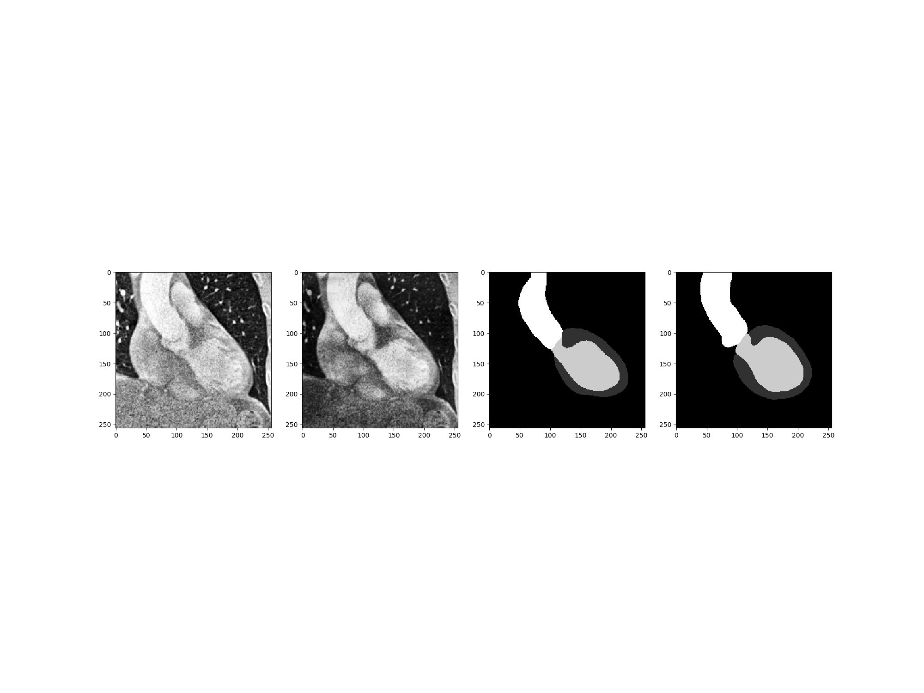


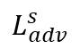
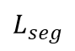
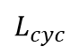
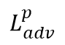
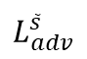
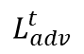
Proposed method
$$L_{cyc}$$
Reconstructed MR
Real MR
MR stylized as CT
Generator
Synergistic Learning
Decoder
$$L_{adv}^{s}$$
CT stylized as MR
$$L_{adv}^{\tilde{s}}$$
Source
Shared
Encoder
$$L_{adv}^{t}$$
MR label
Prediction of MR
$$L_{seg}$$
Real CT
Feature Space
Classifier
$$L_{adv}^{p}$$
Prediction of CT
Target

Slide 6
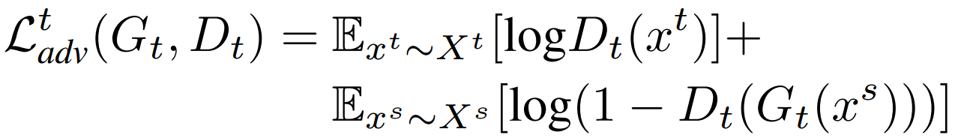
Proposed method
Real MR
MR stylized as CT
Generator
Source
$$L_{adv}^{t}$$
Real CT
Target

Slide 7
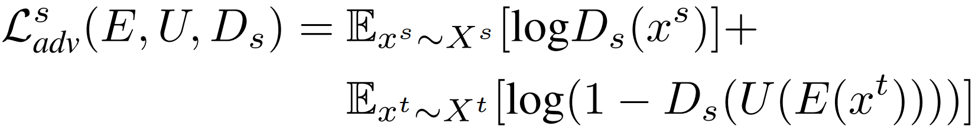
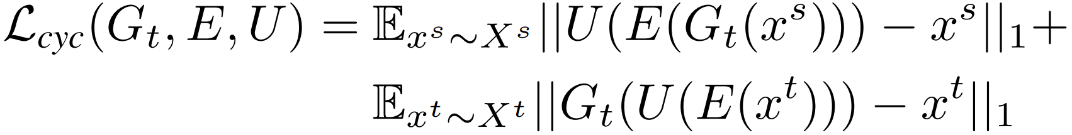
Proposed method
$$L_{cyc}$$
Reconstructed MR
Real MR
MR stylized as CT
Generator
Synergistic Learning
Decoder
$$L_{adv}^{s}$$
CT stylized as MR
Source
Shared
Encoder
$$L_{adv}^{t}$$
Real CT
Feature Space
Target

Slide 8
Proposed method
$$L_{cyc}$$
Reconstructed MR
Real MR
MR stylized as CT
Generator
Synergistic Learning
Decoder
$$L_{adv}^{s}$$
CT stylized as MR
Source
Shared
Encoder
$$L_{adv}^{t}$$
MR label
Prediction of MR
$$L_{seg}$$
Real CT
Feature Space
Classifier
Target

Slide 9
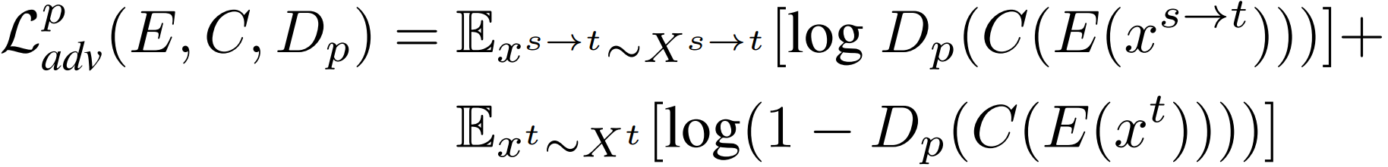
Proposed method
$$L_{cyc}$$
Reconstructed MR
Real MR
MR stylized as CT
Generator
Synergistic Learning
Decoder
$$L_{adv}^{s}$$
CT stylized as MR
Source
Shared
Encoder
$$L_{adv}^{t}$$
MR label
Prediction of MR
$$L_{seg}$$
Real CT
Feature Space
Classifier
$$L_{adv}^{p}$$
Prediction of CT
Target

Slide 10
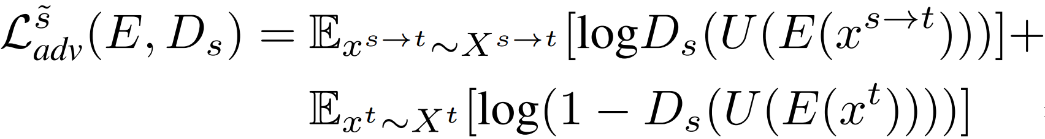
Proposed method
$$L_{cyc}$$
Reconstructed MR
Real MR
MR stylized as CT
Generator
Synergistic Learning
Decoder
$$L_{adv}^{s}$$
CT stylized as MR
$$L_{adv}^{\tilde{s}}$$
Source
Shared
Encoder
$$L_{adv}^{t}$$
MR label
Prediction of MR
$$L_{seg}$$
Real CT
Feature Space
Classifier
$$L_{adv}^{p}$$
Prediction of CT
Target

Slide 11
Inference
Real CT
Shared
Encoder
Prediction of CT
Classifier
Target
Feature Space

Slide 12
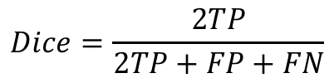
Experiments
Dataset
Multi-Modality Whole Heart Segmentation Challenge 2017 dataset
Unpaired 20 MR and 20 CT volumes collected at different clinical sites
Multi-class segmentation: ascending aorta (AA), the left atrium blood cavity (LAC), the left ventricle blood cavity (LVC), and the myocardium of the left ventricle (MYO).
Evaluation metrics
Dice coefficient
Average surface distance (ASD)
$$Dice=\frac{2TP}{2TP+FP+FN}$$

Slide 13
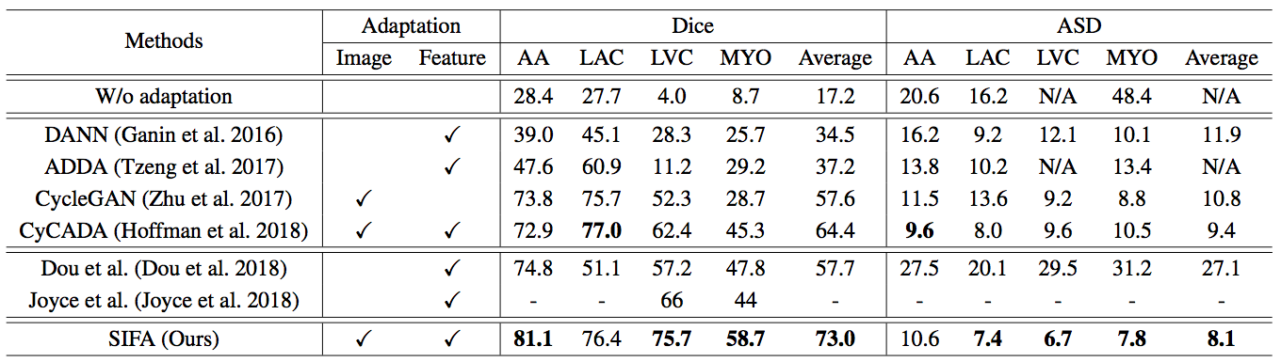
Quantitative results
Compare with the state-of-the-art unsupervised domain adaptation methods

Slide 14
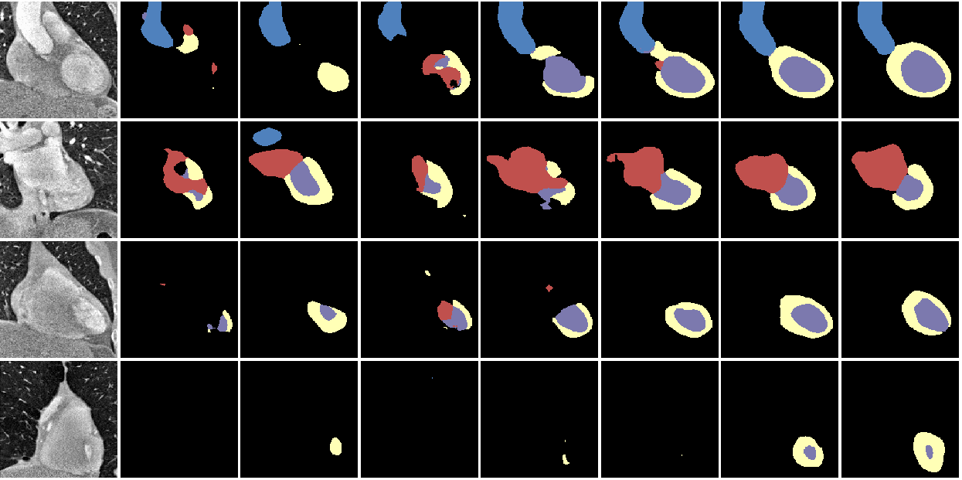
Visual comparison results
CT image
W/o adaptation
DANN
ADDA
CycleGAN
CyCADA
SIFA (Ours)
Ground truth

Slide 15
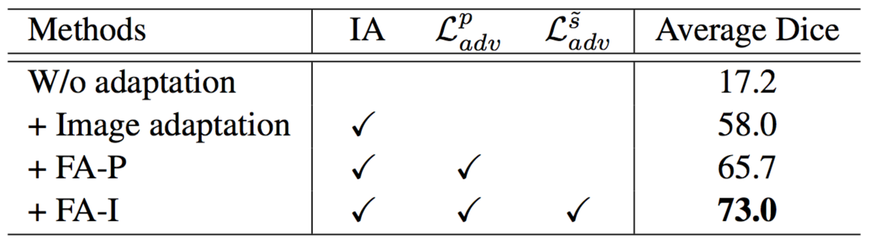
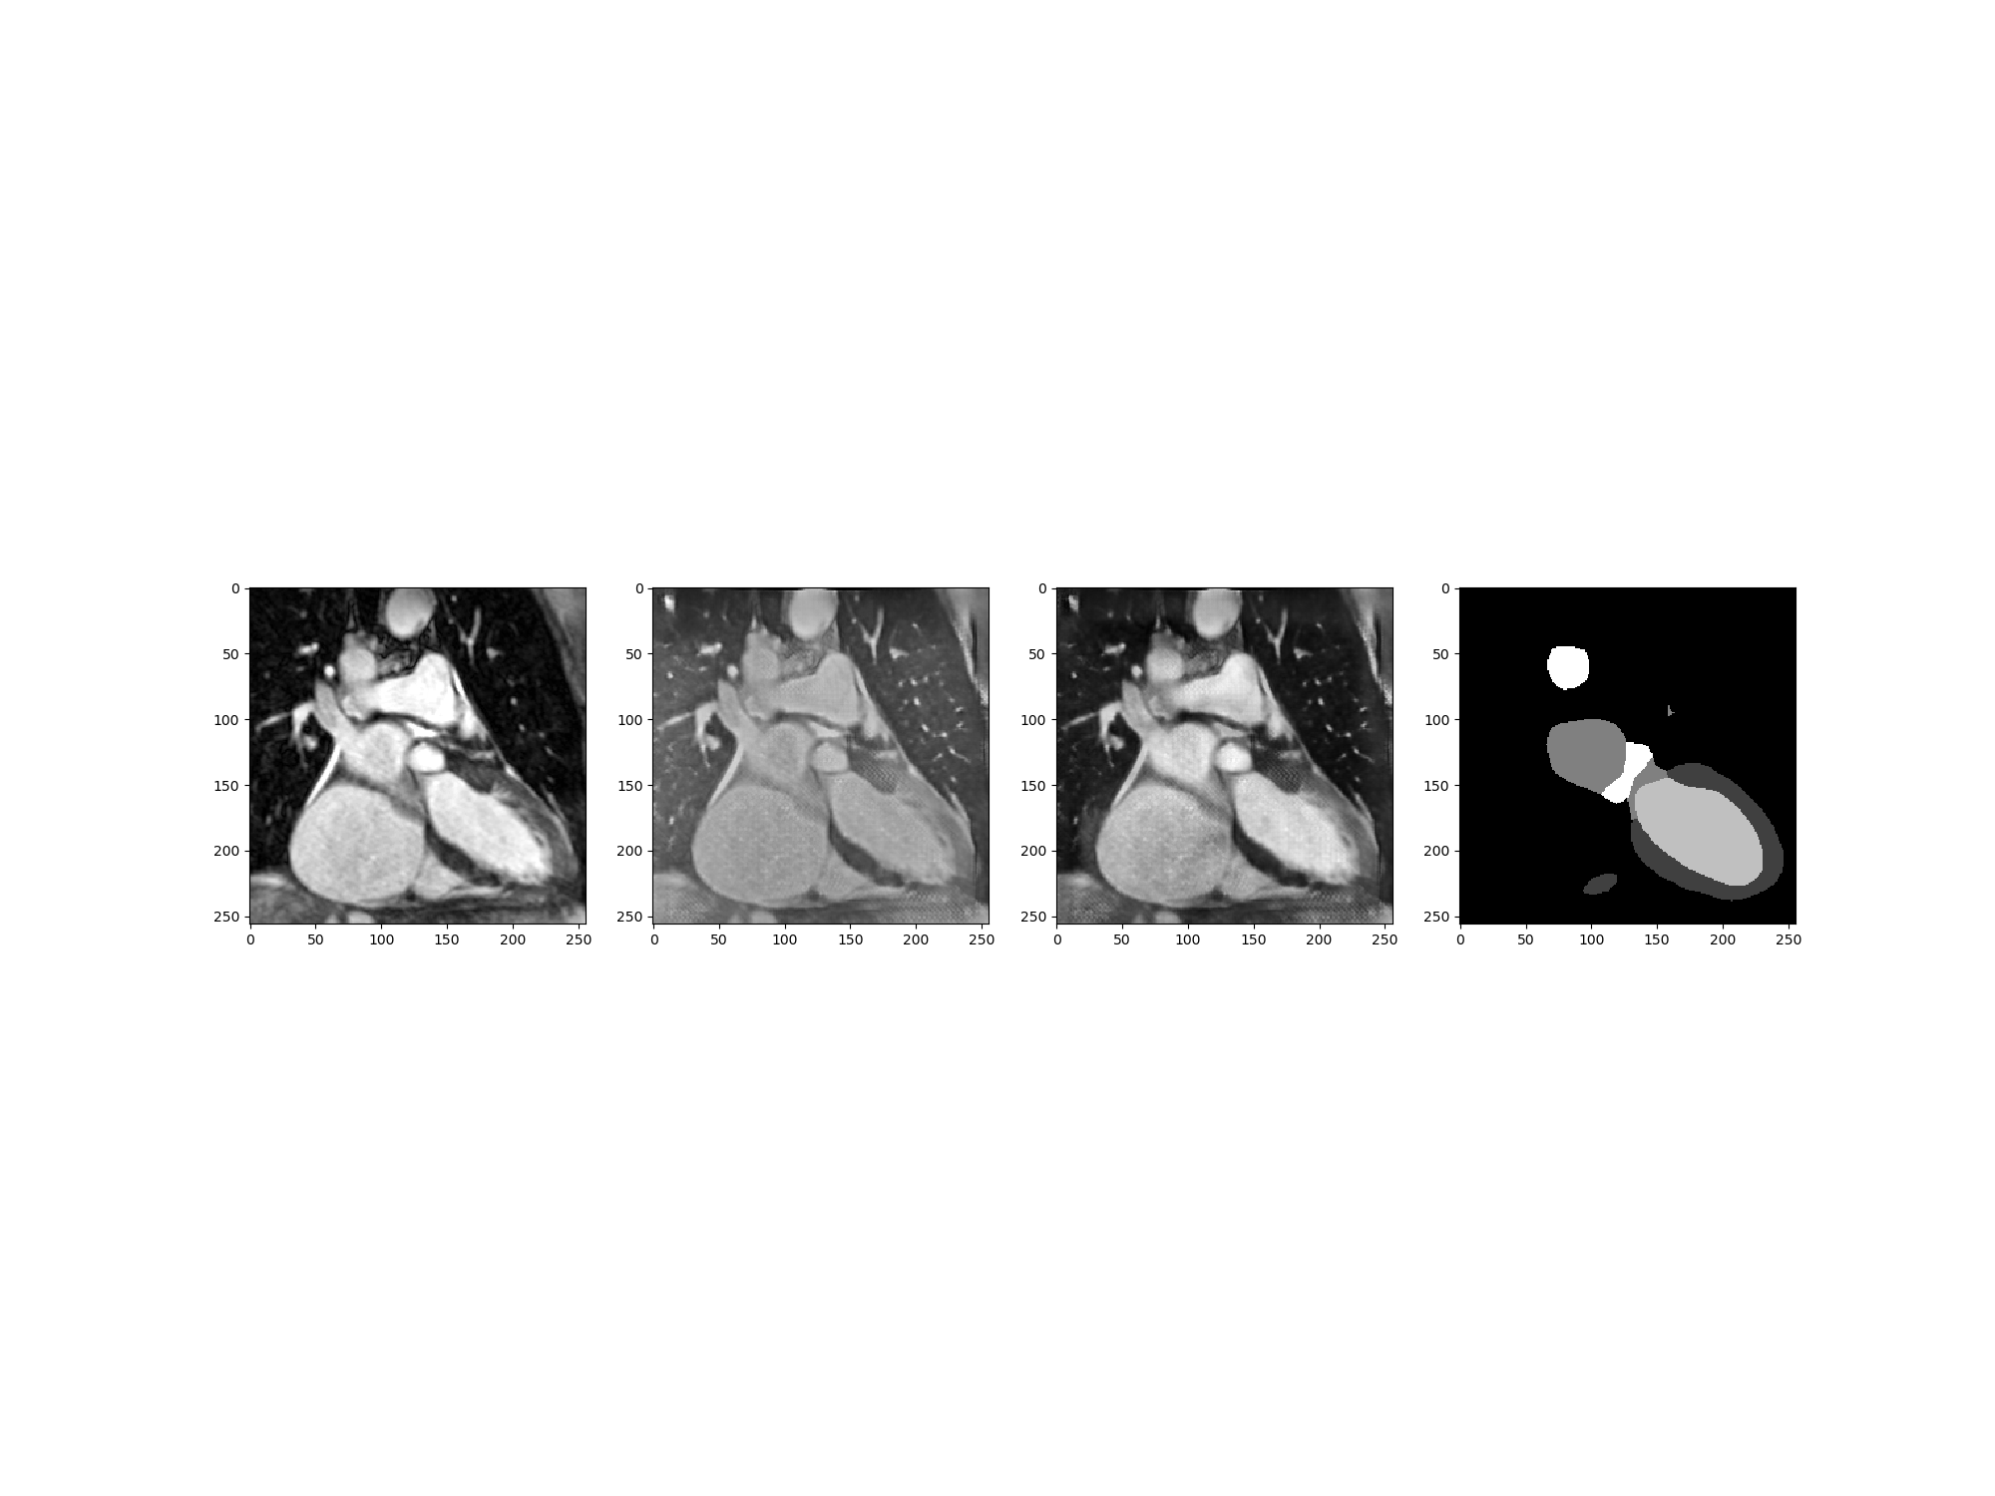

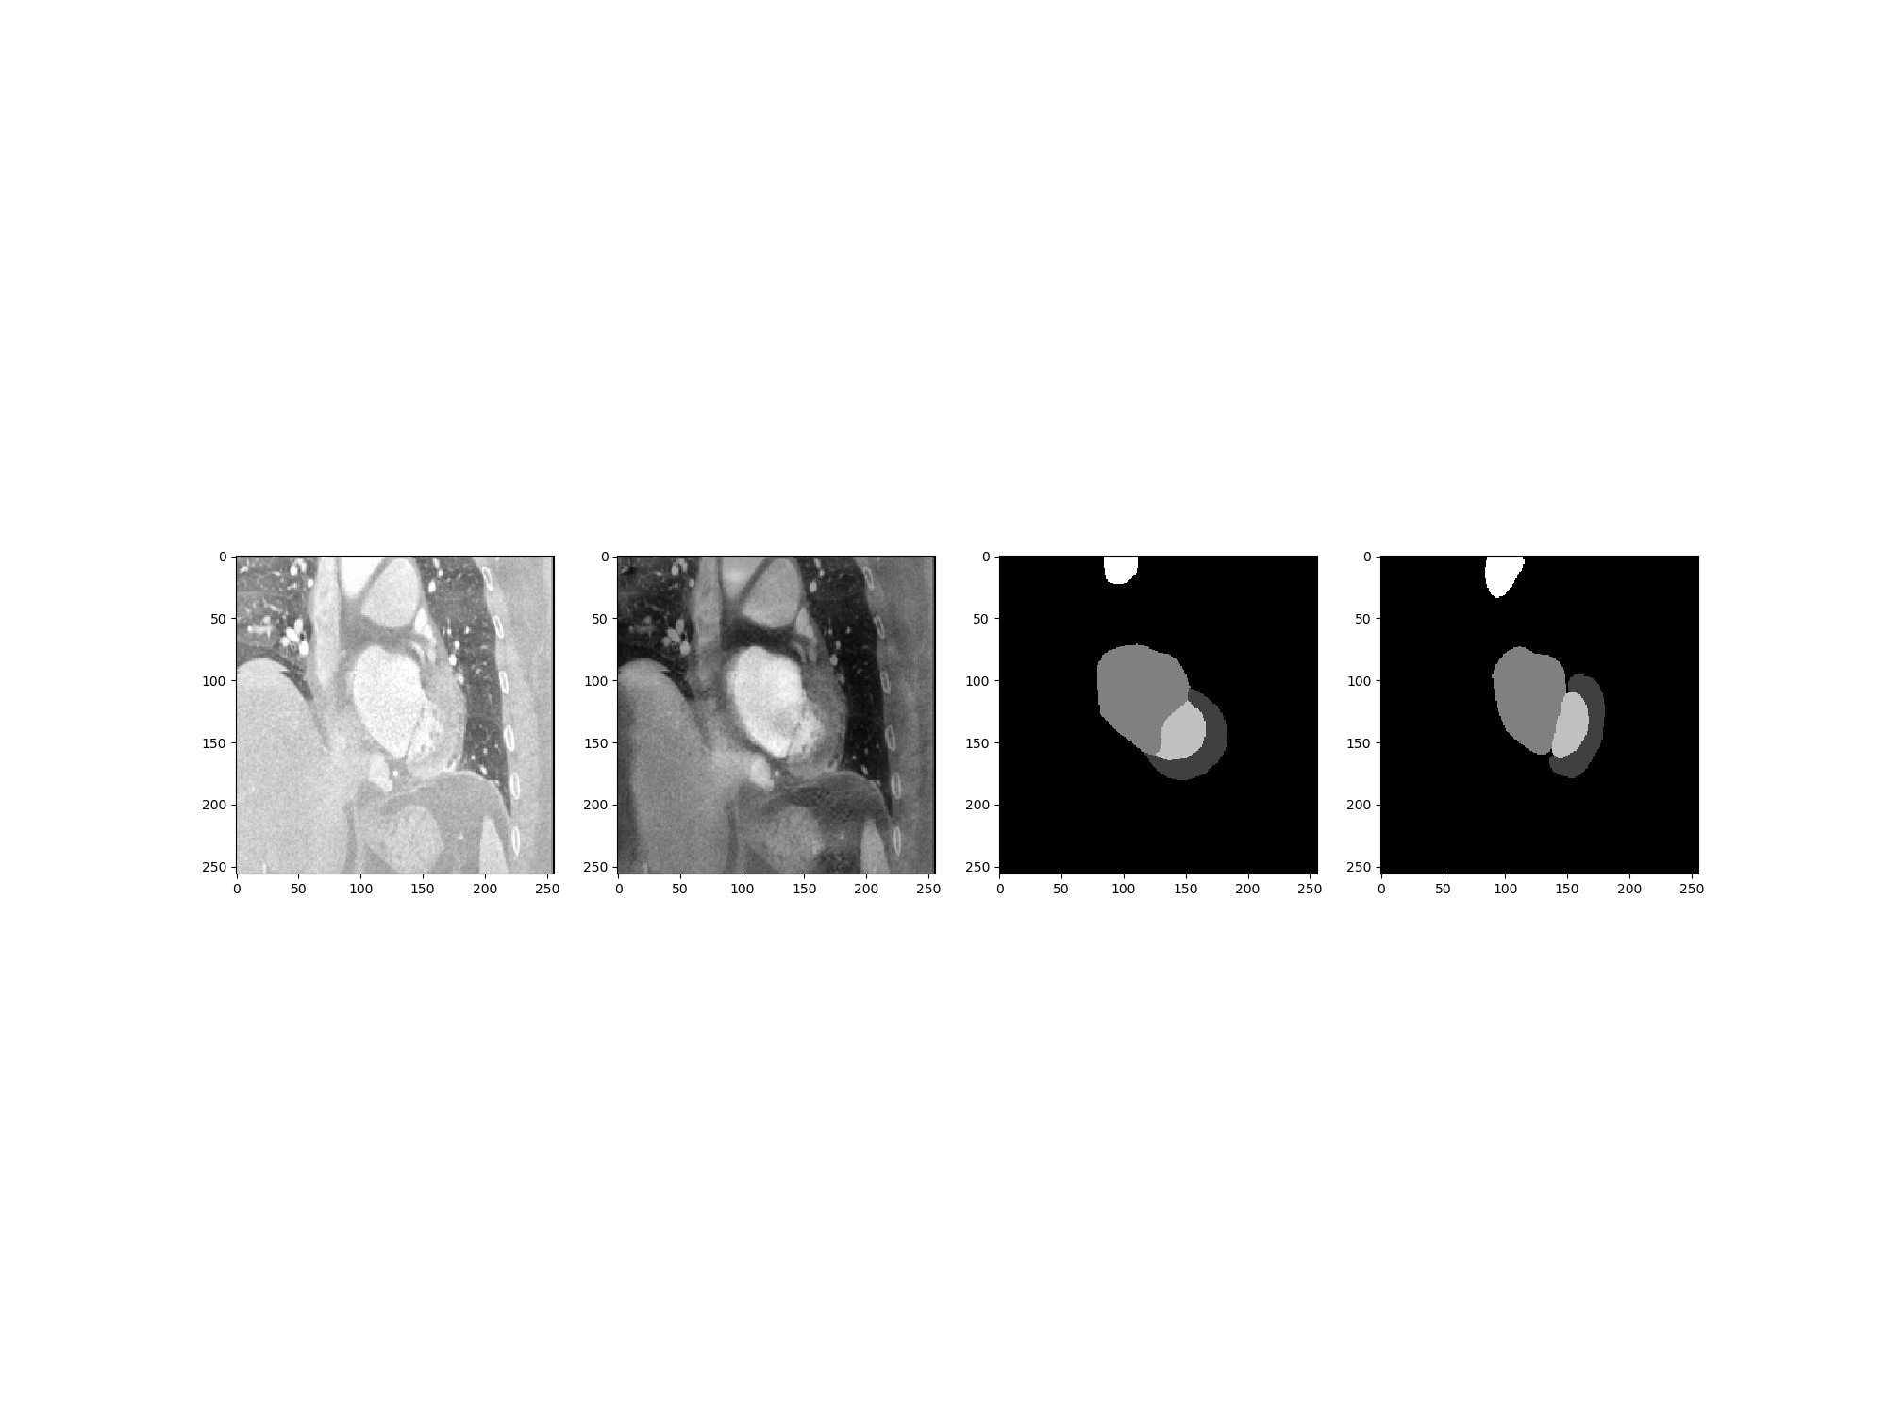
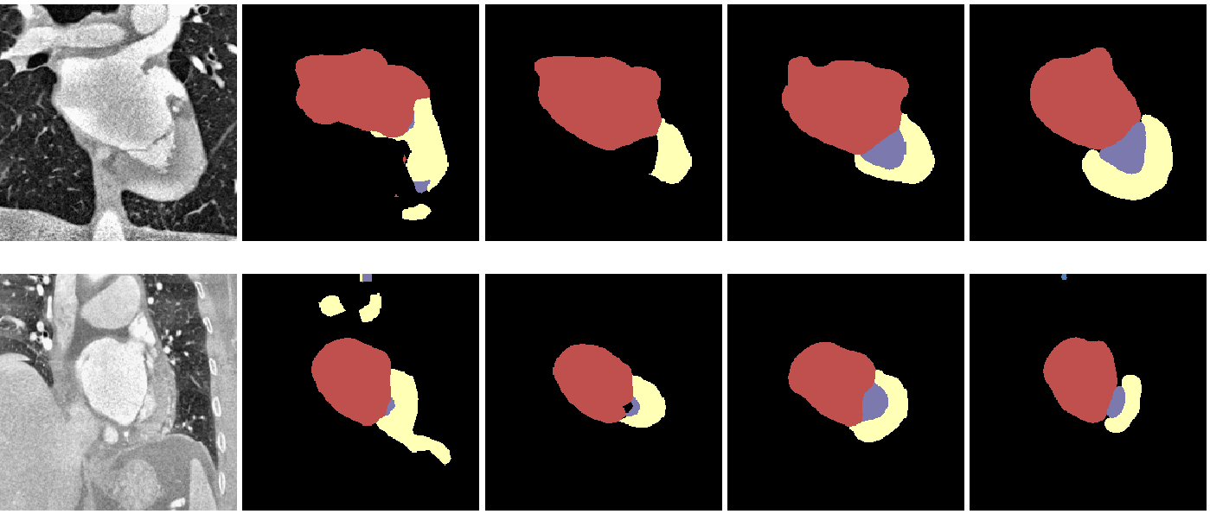
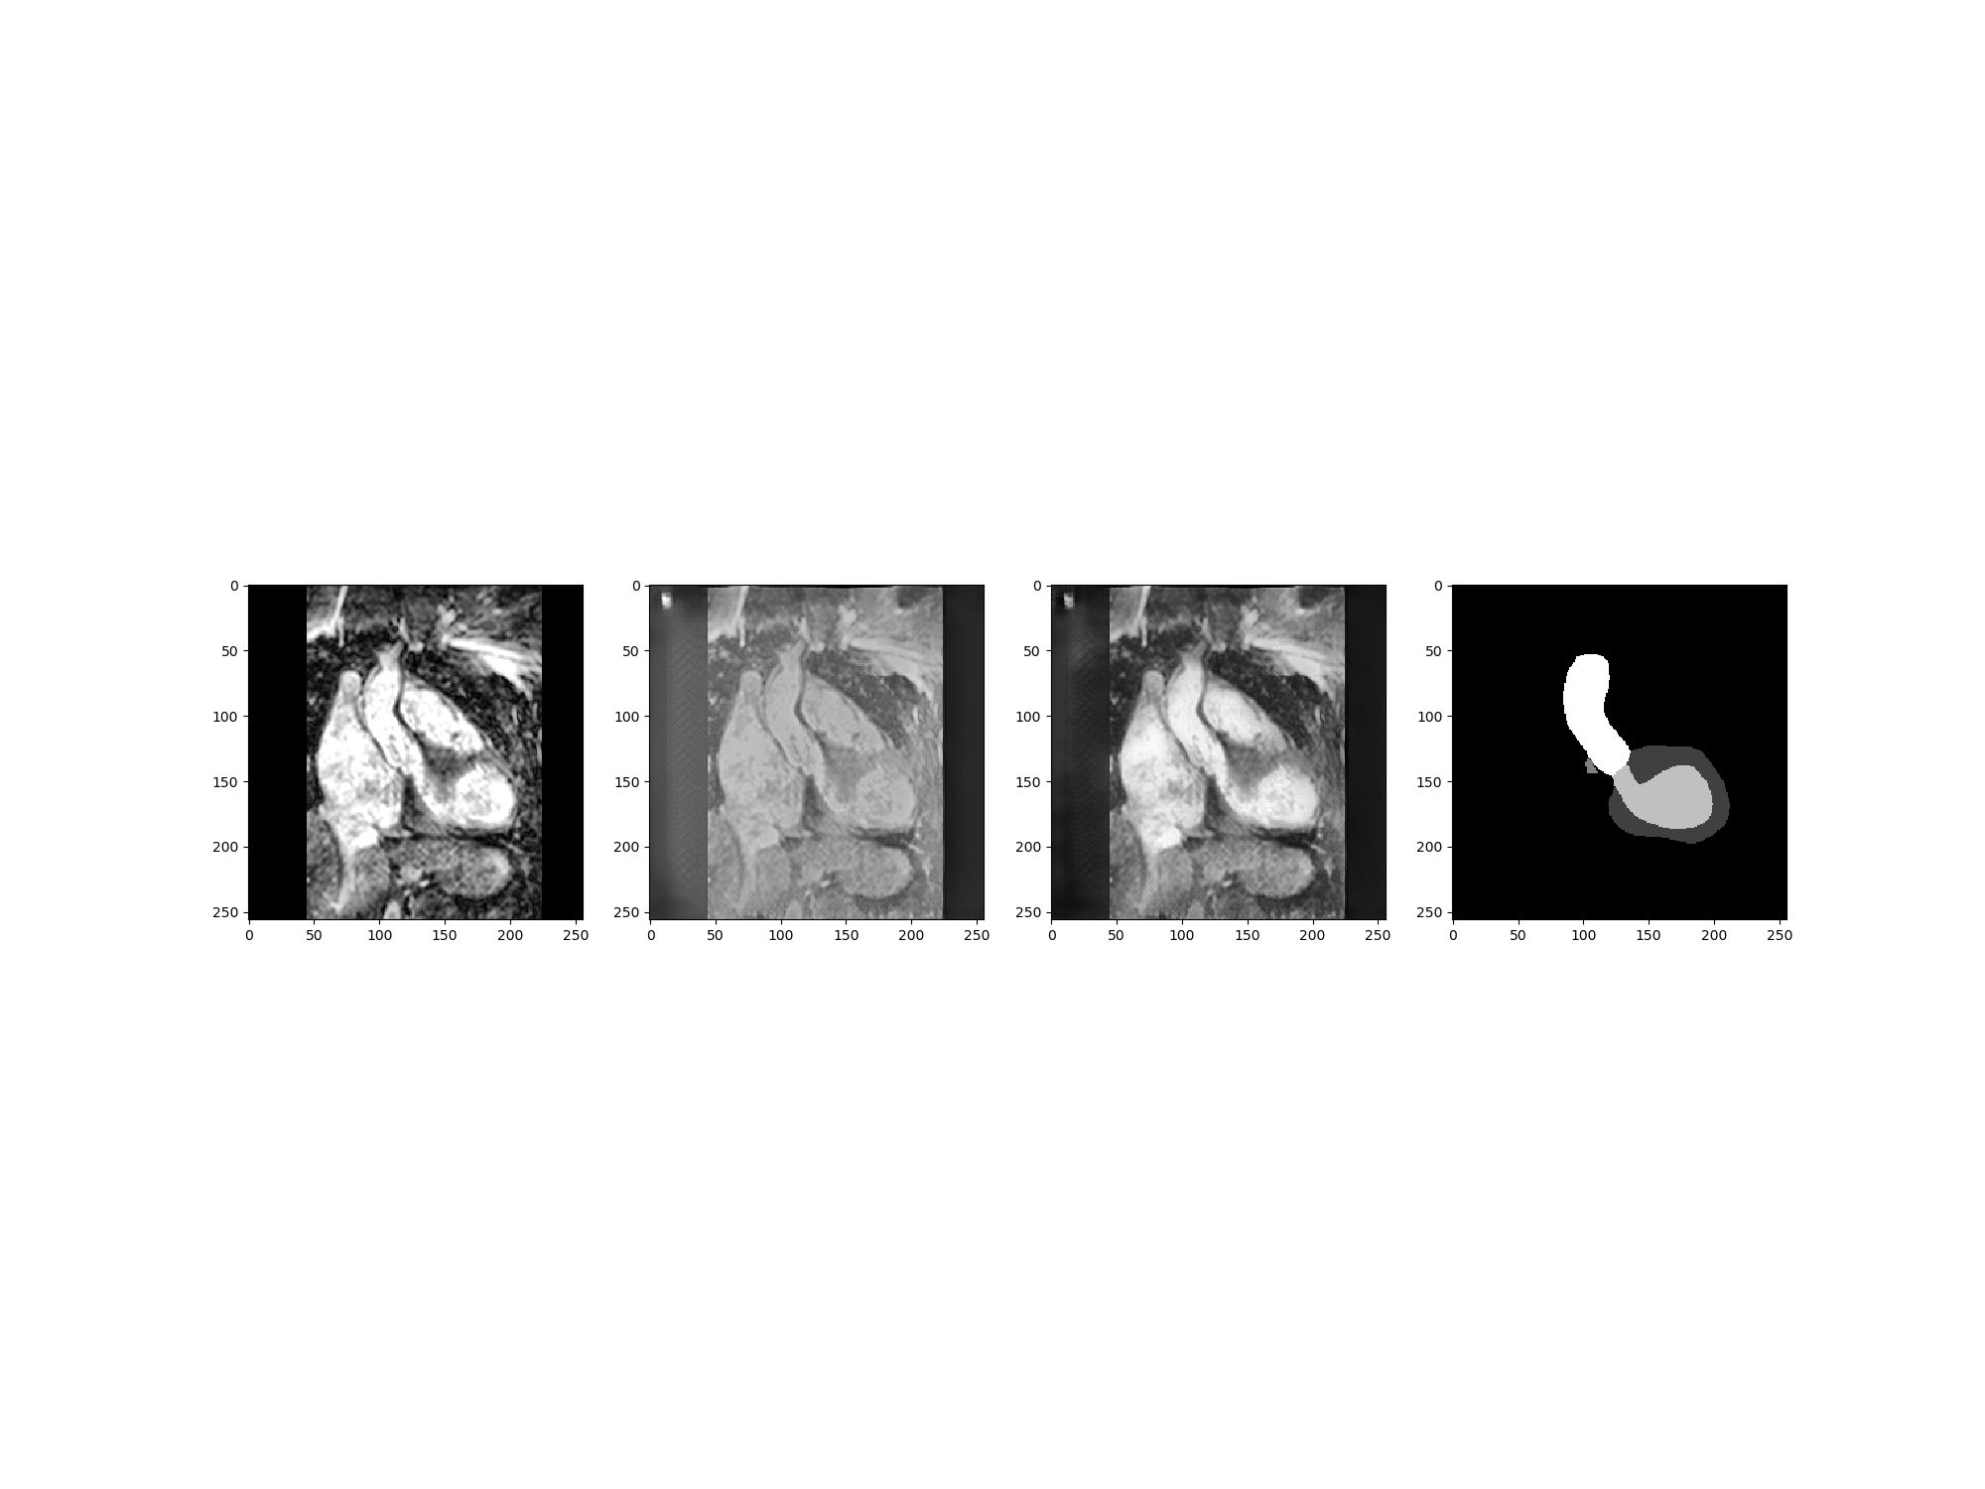
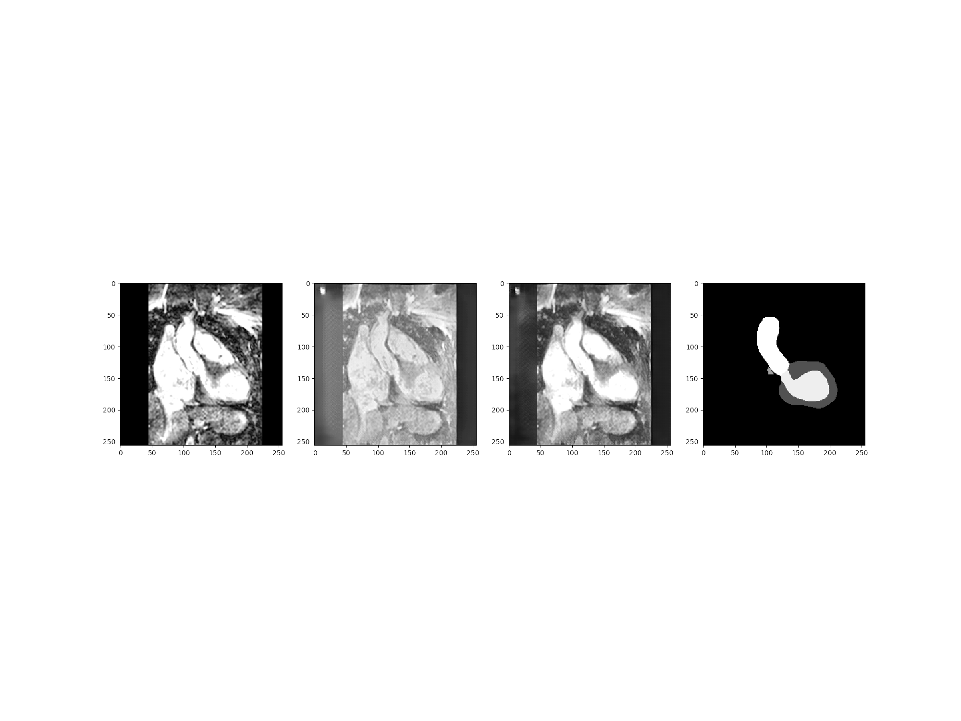
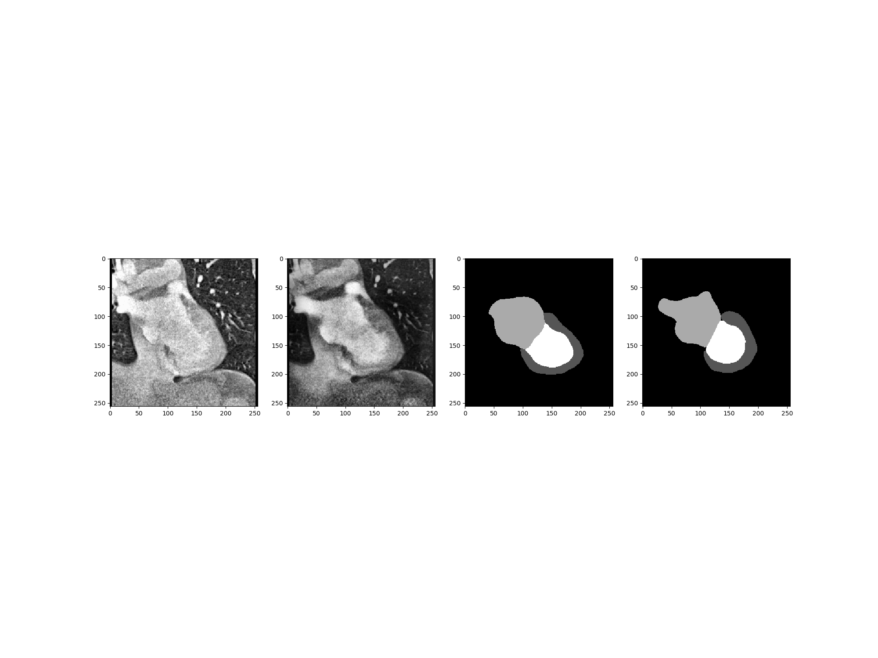
Evaluation of key components
MR
MR stylized as CT
CT
CT stylized as MR
CT image
IA
IA with FA-P
SIFA
Ground truth

Slide 16

Conclusion
Propose synergistic image and feature adaptation to achieve unsupervised domain adaptation from complementary perspectives.
Without using any annotations from the target domain, recovers performance from 17.2% to 73.0%, outperforming the state-of-the-art methods.
Code is available at:
https://github.com/cchen-cc/SIFA

Slide 17
Thank you!
Q & A

